Slide 1
Common
Logical Fallacies
Beware of weak arguments!

Slide 2
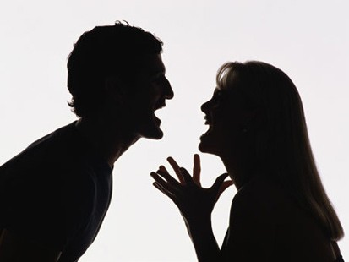
Argument
An “argument” is not a fight.

Slide 3
Argument
Argument = making a point about a subject and supporting it with evidence.

Slide 4
Argument
An argument can be supported with 3 types of evidence…
            Logic
            Ethics
            Emotions

Slide 5
Argument
An argument can be supported by...
Logic (logos):
      Facts
      Statistics
      Expert testimony

Slide 6
Argument
An argument can be supported by...
Ethics (ethos)
      an appeal to one's sense of right and wrong or good sense

Slide 7
Argument
An argument can be supported by...
Emotions (pathos)
      an appeal to one’s patriotism, fears, or sympathies.

Slide 8
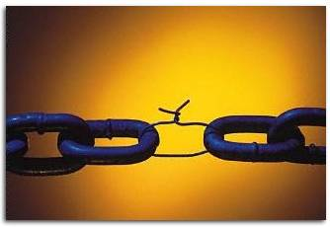
Weak Arguments
Weak arguments rely on illogical statements called fallacies.
  The following slides contain examples of logical fallacies...

Slide 9
The Fallacies

Slide 10
Non-sequitur “Non-SECK-quit-er” aka: “It does not follow”
Logical Fallacies

Slide 11
1. Non-sequitur
("it does not follow")
“Non-SECK-quit-er”
An idea or conclusion that does not follow logically based upon the evidence.

Slide 12
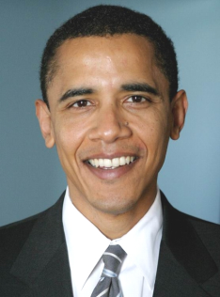

Non-sequitur ("it does not follow")
Example:
The President graduated from Harvard. Therefore, he can't make mistakes.
perfect

Slide 13
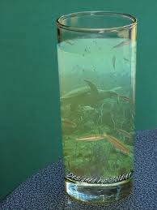


Non-sequitur ("it does not follow")
The ocean is water.
People must drink water to survive.
Therefore, people must drink the ocean to survive.

Slide 14
2. Begging the Question
Logical Fallacies

Slide 15
Begging the Question
Basing an argument on an assumption that has not been proven or that is impossible to prove.
Examples follow on the next few slides:

Slide 16
Begging the Question
People who watch a lot of TV are less active than people who watch no TV
  because the major networks broadcast hidden waves to make people passive and lazy.
Here’s the argument being presented
Here’s the assumption that’s not been proven

Slide 17
Sleep waves
zzzzz……
Wait…
Really??

Slide 18
Begging the Question
The TV argument from the previous slide begs the question:
  “How do you know the TV stations are broadcasting waves to make people sleepy?”
zzzzz……

Slide 19
Begging the Question
Evolution should not be taught in public schools
  because the theory of evolution comes directly from Satan.
Here’s the argument being presented
Here’s the assumption that’s not been proven

Slide 20
“plague?.....no.
Earthquake ?.....no.
I know—Evolution!! ”
Wait…
Really??

Slide 21
Begging the Question
The Evolution argument from the previous slide begs the question:
  “How do you know the theory of Evolution comes from Satan?”

Slide 22

Circular Reasoning
Logical Fallacies

Slide 23
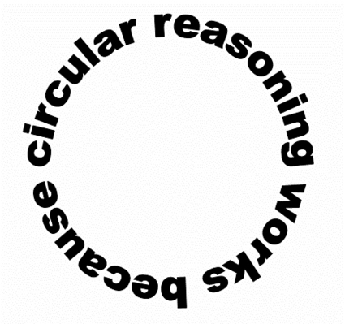
Circular Reasoning
repeats an idea rather than giving a valid reason.

Slide 24
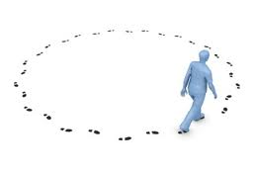
Circular Reasoning
Martha is a good supervisor because she supervises personnel effectively.

Slide 25
Circular Reasoning
A publication is pornographic only if it contains pornography.
How do I know if it’s pornographic?
Oh, you’ll know…

Slide 26
Circular Reasoning
The politician was truthful because he told us he always tells the truth.
I wouldn’t lie about telling the truth!!

Slide 27
4. Straw-Man Argument
Logical Fallacies

Slide 28
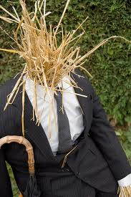

Straw-Man Argument
Gives false characteristics to an argument and then attacks the argument based on those false characteristics.
Just look at him!! He probably wants to take all your money too!!

Slide 29
Straw-Man Argument
This argument simply ignores a person's actual position and substitutes a distorted, exaggerated or misrepresented version of that position.
“The school lunch budget must be examined to cut out waste.”
This guy wants to STARVE our children!!

Slide 30
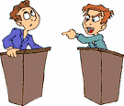
Straw-Man Argument
The Straw-man argument attempts to "prove" a point by overstating, exaggerating, or over-simplifying the arguments of the opposing side.
Clearly, this guy wants to bleed taxpayers dry with these increases!

Slide 31
5. Ad Hominem aka “To the man”
Logical Fallacies

Slide 32
Ad Hominem (to the man)
This argument focuses attention on people rather than on arguments or evidence.
  It attacks the person rather than the issue.

Slide 33
Ad Hominem (to the man)
Example:
Sam is out of shape, so how can he be an effective mayor?

Slide 34
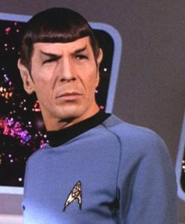

Ad Hominem (to the man)
Example:
Mr. Spock is not an effective second-in- command because he has ugly pointed ears.
Ugly!! And pointed!!

Slide 35
Ad Hominem (to the man)
Examples:
Dr. Kirkegard’s books about plant genetics are worthless because she was caught shoplifting.
The plants know nothing about it!!
Stolen merchandise

Slide 36
6. Overgeneralization
Logical Fallacies

Slide 37
Overgeneralization
An overgeneralization draws a conclusion about an entire group, topic, or place based on insufficient evidence.
      Stereotypes are one kind of overgeneralization.

Slide 38
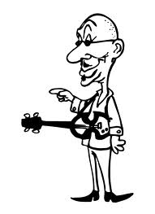
Overgeneralization
Example:
“I know several bald musicians. Bald men must be musically talented.”

Slide 39
Overgeneralization
Example:
“Every time I’ve been to Florida, the weather has been rainy. It’s always raining in Florida!”

Slide 40
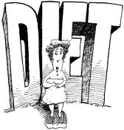
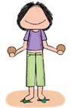
Overgeneralization
Example:
“My mother, sister, and girlfriend diet all the time. Women are always on a diet!!”

Slide 41
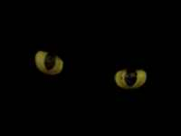
7. Post hoc Reasoning aka: “Black cat syndrome”
Logical Fallacies

Slide 42

Post hoc Reasoning
The full name of this fallacy is:
“Post Hoc Ergo Propter Hoc”
After a black cat crossed my path, I failed my math test. That cat caused me to fail!!
After this;
therefore,
because of this

Slide 43

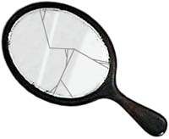

Post hoc Reasoning
This fallacy is also known as:
False or Doubful Cause
Questionable Cause
Mistaking Coincidence for Cause

Slide 44

Post hoc Reasoning
Example:
He was listening to rap music before robbing the bank. The rap music caused him to commit the crime!
Rap music again!!

Slide 45
8. False Dichotomy aka: “Either-or fallacy”
Logical Fallacies

Slide 46
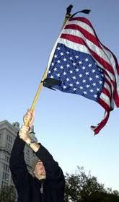
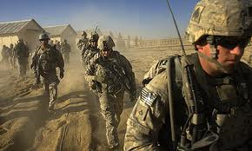
False Dichotomy
Examples:
Either you support sending more troops to the Middle East or you are America’s enemy.

Slide 47

False Dichotomy
Example:
“If you don’t drive this car, you might as well not drive at all.”
So it’s this or the bus?

Slide 48
False Dichotomy
Example:
“You can either stay at your current job or quit and live in poverty.”
This is better than poverty…I guess.

Slide 49
False Dichotomy
Presents the false assumption that there are only two possibilities.
  Sometimes called the “False Dilemma” or the “Either/Or” fallacy.
Most situations provide more than two possible outcomes.

Slide 50

9. Red Herring
Logical Fallacies

Slide 51
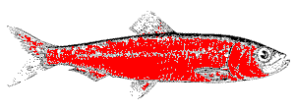
Red Herring
...named after a strong-smelling fish, the scent of which throws hounds off the scent of a trail.
The Red Herring occurs when one changes the subject to draw attention away from the main issue.
    The focus is shifted to a side issue or something irrelevant.

Slide 52

Red Herring
Example:
“You’re a vegetarian because you disagree with killing animals? So then how can you support abortion rights?”
Abortion and vegetarianism are 2 different subjects, that’s how!!

Slide 53

Red Herring
Example:
"I work 60 hours a week to support my family, and I pay my taxes; you shouldn't arrest me just because I drove a little drunk!”
Nice try, but I recognize a red herring when I hear one.

Slide 54
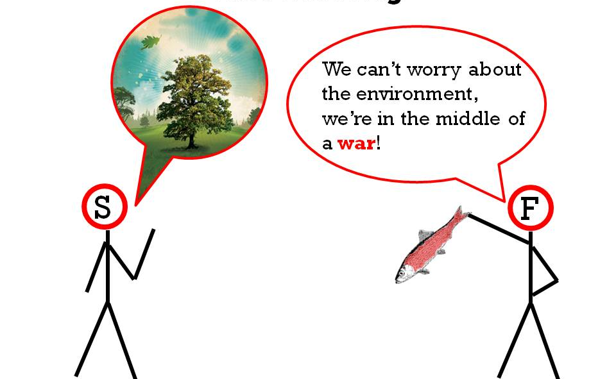
Red Herring

Slide 55



Red Herring
You’re not looking at the big picture. Our company helps citizens with jobs and charity drives. We even provide college scholarships for local students!
Why did your company dump toxic chemicals in the river?

Slide 56
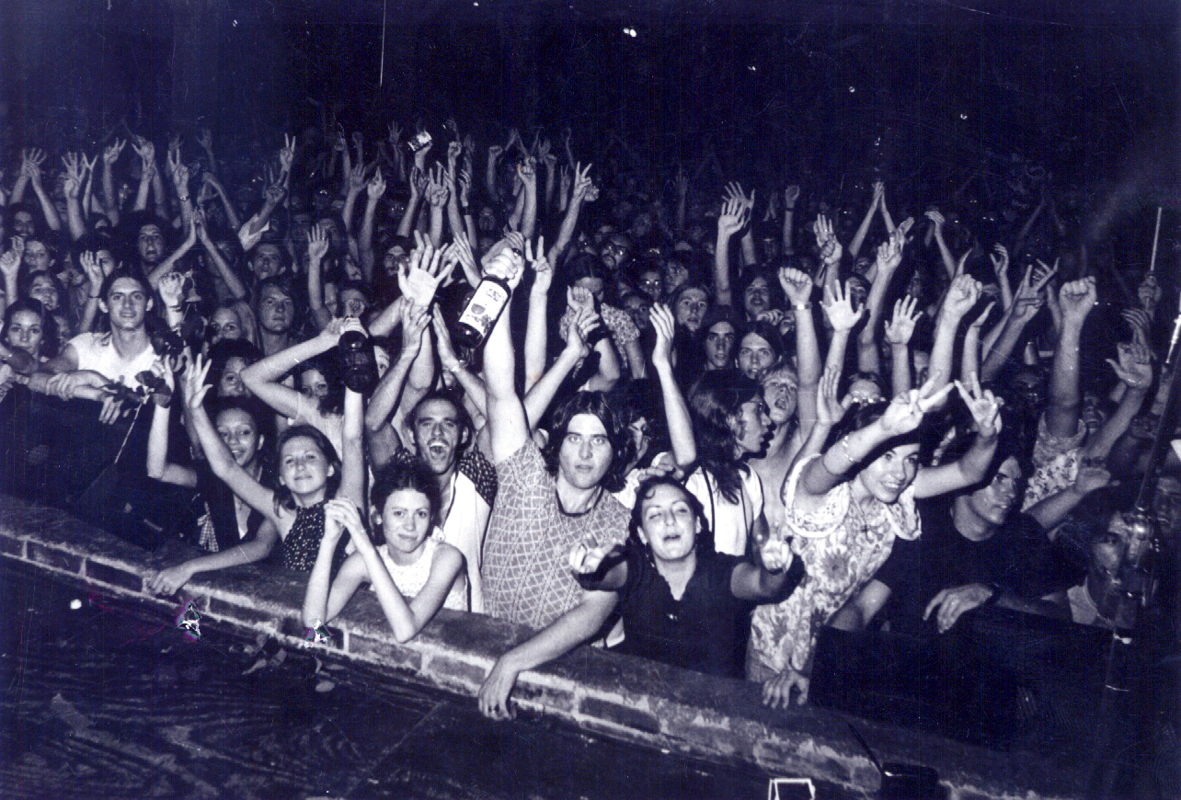
10. Appeal to the Crowd
Logical Fallacies

Slide 57
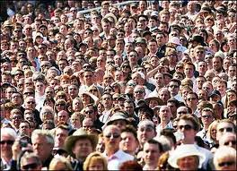
Appeal to the Crowd
“argumentum ad populum” or
“Bandwagon”
relying on the emotional passion of the crowd in making an argument; playing on a group's fears or prejudices.

Slide 58
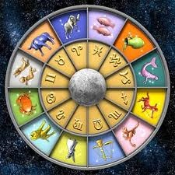

Appeal to the Crowd
Example:
“Millions of people believe in astrology, so there must be some truth to it.”

Slide 59
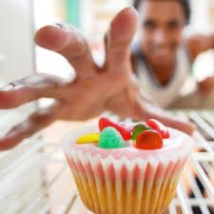

Appeal to the Crowd
“All I can say is that if enjoying junk food is unhealthy, then most of us are unhealthy!”

Slide 60
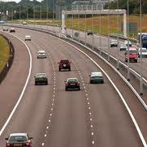
Appeal to the Crowd
Speeding is not all that bad because everyone does it.

Slide 61
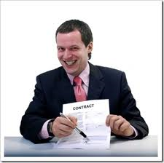
Appeal to the Crowd
“Of course you want our payment plan; everybody takes advantage of that!”

Slide 62
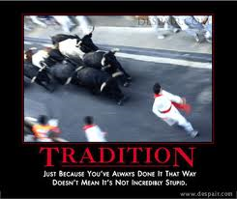
11. Appeal To Tradition
Logical Fallacies

Slide 63
Appeal To Tradition:
This argument says something is good or correct because it is a tradition.
In other words…
“We should continue to do things as they have been done in the past.”

Slide 64
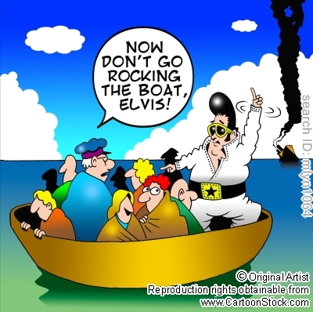
Appeal To Tradition:
...This fallacy says
“We shouldn't challenge time-honored customs or traditions.”
“Don't rock the boat”

Slide 65
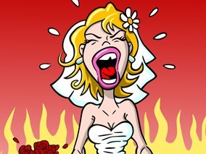
Appeal To Tradition:
“Of course you have to play Here Comes the Bride at your wedding, because that's always been the song that is played.”
But I hate that song!!!!

Slide 66
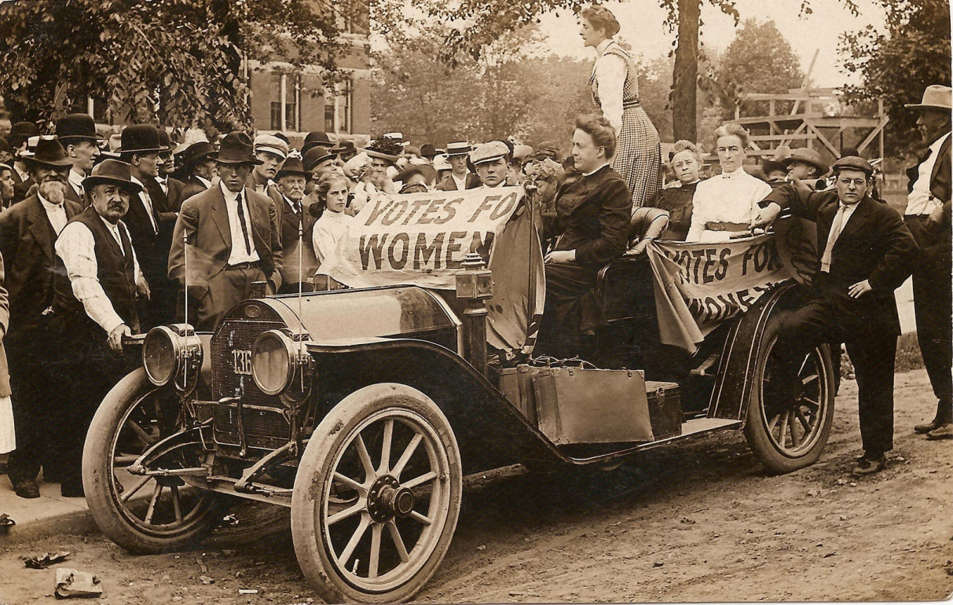
Appeal To Tradition:
“Tradition” is not always good.
Women have never voted! Why change tradition?

Slide 67
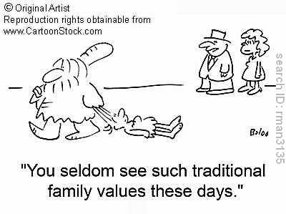
Appeal To Tradition:
“Tradition” is not always good.

Slide 68
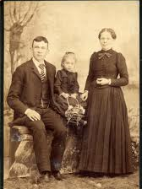
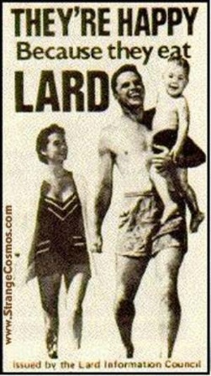
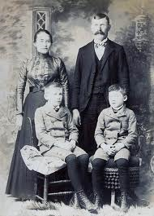
Appeal To Tradition:
“Tradition” is not always good.
I used lard!
My family has always cooked in lard, so why break tradition?
I love lard!!

Slide 69
Many more logical fallacies exist...
Be on the lookout for them in all of your reading and research!
End of Presentation.

